Slide 1
Object Oriented Programming and Design
Presented by
Dr Ramya Devi M
mramyadevi@wilp.bits-pilani.ac.in
CS - 05 : 26th Jul 2025

Slide 2


Slide 3
IMP Note to Students
It is important to know that just login to the session does not guarantee the attendance.
Once you join the session, continue till the end to consider you as present in the class.
IMPORTANTLY, you need to make the class more interactive by responding to Professors queries in the session.
Whenever Professor calls your number / name ,you need to respond, otherwise it will be considered as ABSENT

Slide 4
Object-Oriented Design Process

Slide 5
Objectives
To explain how a software design may be represented as a set of interacting objects that manage their own state and operations
To describe the activities in the object-oriented design process
To introduce various models that describe an object-oriented design
To show how UML may be used to represent these models

Slide 6

Topics covered
Qualities of a good software
Object Oriented Software Life Cycle
Objects and object classes
An object-oriented design process
Case Study

Slide 7

Qualities of Good Software
Software is treated as a good software by means of different factors.
A software product is concluded as a good software by what it offers and how well it can be used.
The factors that decide the software properties are divided into three categories:
Operational,
Transitional, and
Maintenance

Slide 8

Qualities of Good Software
Operational:
In operational categories, the factors that decide the software performance in operations. It can be measured on:
Budget
Usability
Efficiency
Correctness
Functionality
Dependability
Security
Safety

Slide 9
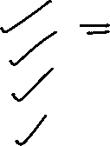
Qualities of Good Software
Transitional:
When the software is moved from one platform to another, the factors deciding the software quality:
Portability
Interoperability
Reusability
Adaptability

Slide 10

Qualities of Good Software
Maintenance:
In this categories all factors are included that describes about how well a software has the capabilities to maintain itself in the ever changing environment:
Modularity
Maintainability
Flexibility
Scalability

Slide 11
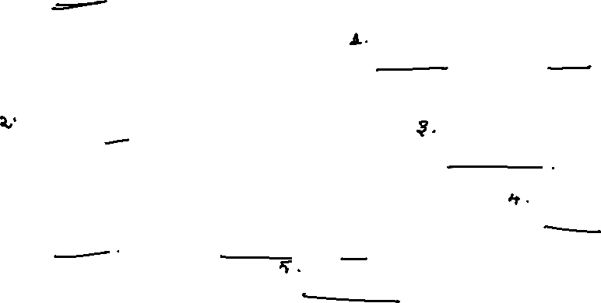
Object-oriented Life Cycle Model in Software Engineering
The object-oriented life cycle model considers 'objects' as the basis of the software engineering process.
The development team starts by observing and analyzing the system they intend to develop before defining the requirements.
Once the process is over, they focus on identifying the objects of the system.
Now, an object could be anything; it can have a physical existence like a customer, car, etc.
An object also constitutes intangible elements like a process or a project.

Slide 12
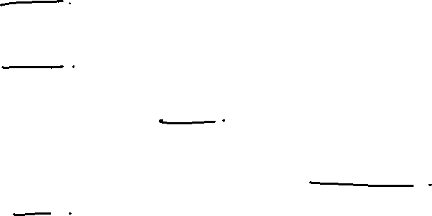
Advantages of Object-Oriented Life Cycle Model
Apart from enhancing the system performance, object-oriented programming offers some advantages such as:
It is data-focused and easy to work with problem domains.
It uses encapsulation and data hiding process that allows a developer to build tamper-proof systems.
It enables software modularity, making it easier to manage and maintain complex software.
It allows developers to create new modules using existing models, saving time and development cost of organizations.

Slide 13
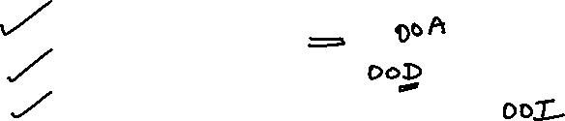
Object-Oriented Software Engineering
The primary objectives of the Object-Oriented Model
Object-oriented Analysis
Object-oriented Design
Object-oriented Implementation

Slide 14

Object-Oriented Analysis (OOA)
Object-oriented analysis consists of the process where a development team evaluates the system and organizes the requirements as objects.
Contrary to traditional structural analysis, the OOA heavily depends on advanced data like Use Cases and Object Models.
Use case
Use Cases are written descriptions about how users will behave when they enter your website or application.
It comprises the goals of each user from the point of their entry to exit.

Slide 15
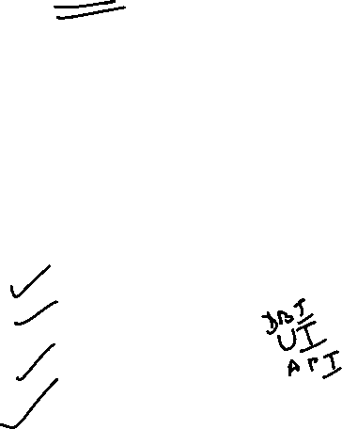
Object-Oriented Analysis (OOA)
Object Model
An object model allows the development team to create an architectural software or system model before implementing or programming.
It helps in defining a software/system (Application) in objects and classes.
It informs the developers about
Interaction between different models
Inheritance
Encapsulation
Other types of object-oriented interfaces

Slide 16

Object-oriented Design
Designing systems using self-contained objects and object classes

Slide 17

Object-oriented development
Object-oriented analysis, design and programming are related but distinct
OOA is concerned with developing an object model of the application domain – Identifying the objects
OOD is concerned with developing an object-oriented system model to implement requirements – System architecture using the identified objects.
OOP is concerned with realising an OOD using an OO programming language such as Java or C++ - Coding

Slide 18
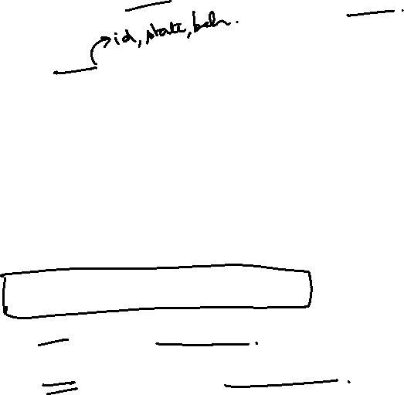
Objects and object classes
Objects are entities in a software system which represent instances of real-world and system entities
Object classes are templates for objects.
Classes of real world object are defined and used to create objects in the software system.
Object classes may inherit attributes and services from other object classes.
Object = Data + Methods
Data = State of the object
Method = Behaviour of the object

Slide 19
The Unified Modeling Language
Several different notations for describing object-oriented designs were proposed in the 1980s and 1990s
The Unified Modeling Language is an integration of these notations
It describes notations for a number of different models that may be produced during OO analysis and design
It is now a de facto standard for OO modelling

Slide 20

Introduction to UML diagrams
There are 9 UML diagrams. They are
Use case diagram
Class diagram
Object diagram
Sequence diagram
Collaboration diagram
State chart diagram
Activity diagram
Deployment diagram
Component diagram

Slide 21

UML Diagram - Categories
UML defines various kinds of diagrams to cover most of the aspects of a system.
There are two broad categories of diagrams
1. Structural Diagrams
2. Behavioral Diagrams
These are further divided into sub-categories

Slide 22
Structural Diagrams
The structural diagrams represent the static aspect of the system.
These static aspects represent those parts of a diagram which forms the main structure and therefore stable.
These static parts represent classes, interfaces, objects, components and nodes.
The four structural diagrams are:
(i) Class diagram
(ii) Object diagram
(iii) Component diagram
(iv) Deployment diagram

Slide 23
Behavioral diagrams
Behavioral diagrams basically capture the dynamic aspect of a system.
Dynamic aspect can be further described as the changing/moving parts of a system.
The five behavioral diagrams are:
Use case diagram
Sequence diagram
(iii) Collaboration diagram
(iv) State Chart diagram
(v) Activity diagram

Slide 24
Use case and Use case diagrams
Use case is one way of representing system functionality.
Use case refers to
  A system’s behavior (functionality)
  A set of activities that produce some output.
Use verbs (Action words) for naming use cases.
Use case diagrams represent system’s behavior using use cases and actors.
Provides a global look of a system that gives insight into functionality (use cases) and environment (actors).
Useful for early structuring of requirements; iterative revisions

Slide 25
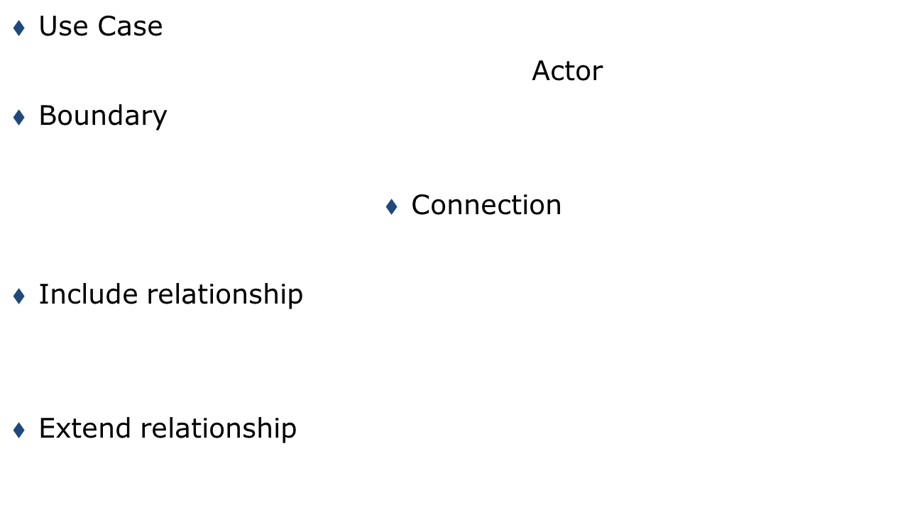

Use Case Symbols
<<include>>
<<extend>>
Note: different names
used in different software

Slide 26
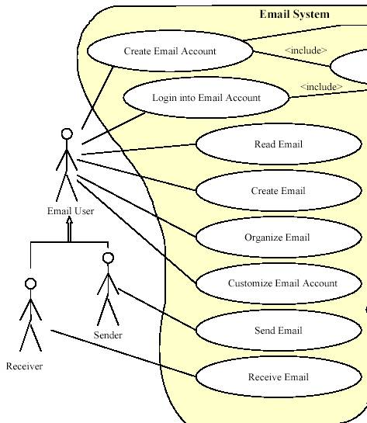
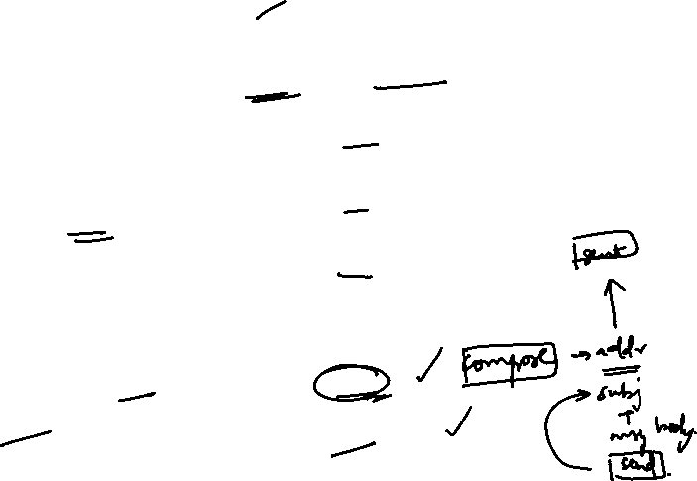
Use Cases of Email System – End User View (partial)

Slide 27
USE CASE DIAGRAM
These diagrams represent the use case view of a system.
A use case is a summary of scenarios of a single task.
A scenario is an example of what happens when someone communicates / interacts with the system.
Example 1 - For an order management system, we know that salesperson is the actor who does the sale to the customer.
The simple use case diagram for the order management system is as follows:

Slide 28
USE CASE DIAGRAM
The diagram for order processing system
Actor is the Salesperson
Communication
Does the sale for a customer
Actor

Slide 29
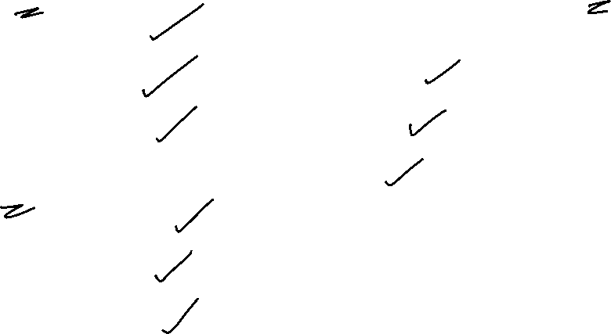
USE CASE DIAGRAM – Detailed – Order processing
Salesman Admin
Manage Customers
Manage Bill Manage Users & Application
Manage Payment Manage Product
Manage order
Customer
Create order report
View Invoice
Make Payment

Slide 30
Use case diagrams - Summary
Use cases start with a textual description.
Some important details to show in a use case are:
- Name of use case
- Objective
- Actor
- Interactions between use case and actor

Slide 31
UML Class Diagrams- Basics
When it comes to system construction, a class diagram is the most widely used diagram.
This diagram generally consists of interfaces, classes, associations and collaborations.
Such a diagram would illustrate the object-oriented view of a system, which is static in nature.
The object orientation of a system is indicated by a class diagram.
Since class diagrams are used for many different purposes, such as making stakeholders aware of requirements to highlighting your detailed design, you need to apply a different style in each circumstance.

Slide 32
UML Class Diagrams
A class diagram specifies an overview of a system by showing the classes involved in the system and the relationships between them.
A class is a description of a set of objects that share the common attributes, operations, relationships, and semantics.
Graphically, a class is rendered as a rectangle, usually including its name, attributes, and operations in separate, designated compartments.

Slide 33
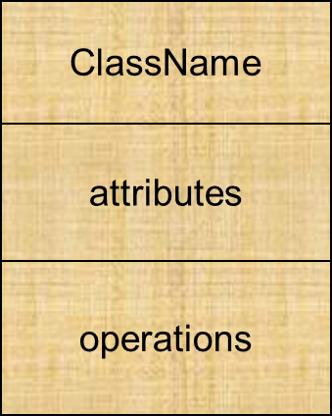

UML Class Diagrams - Basics
A class is represented in the following format

Slide 34
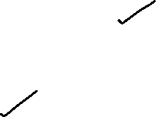
UML Class Diagrams - Basics
The name of the class is the only required tag in the graphical representation of a class.
It always appears in the top-most compartment.
An attribute is a named property of a class that describes the object being modeled.
In the class diagram, attributes appear in the second compartment just below the name-compartment.
Attributes are usually listed in the form:
attributeName : Type

Slide 35
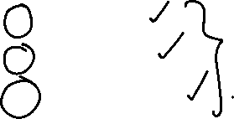
UML Class Diagrams - Basics
A derived attribute is one that can be found from other attributes, but doesn’t actually exist.
For example, the age of a person can be calculated from his / her birth date.
A derived attribute is designated by a Preceding ‘/’ as in: / age : Date
Visibility for the attributes is represented as follows:
+ - Public
- - Private
# - Protected

Slide 36
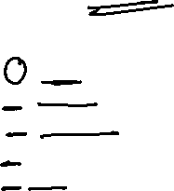
UML Class Diagrams - Basics
The attributes of a person can be specified as
Person
+ ename : String
# eaddress : Address
# ebirthdate : Date
/ eage : Date
- essn : Id

Slide 37

UML Class Diagrams - Basics
Operations specify the class behavior and appear in the
third compartment.
Person
ename : String
eaddress : Address
ebirthdate : Date
essn : Id
Eat()
Sleep()
Work()
Play()

Slide 38
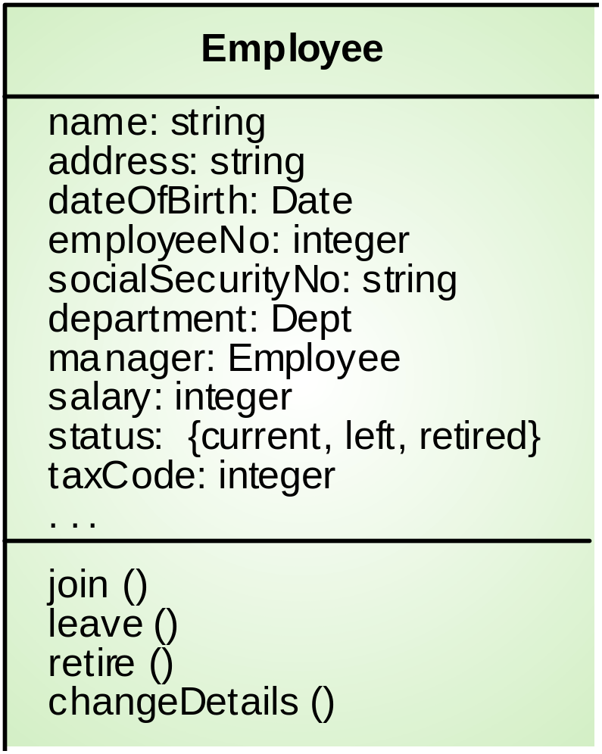
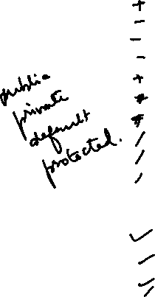
Employee object class (UML)

Slide 39
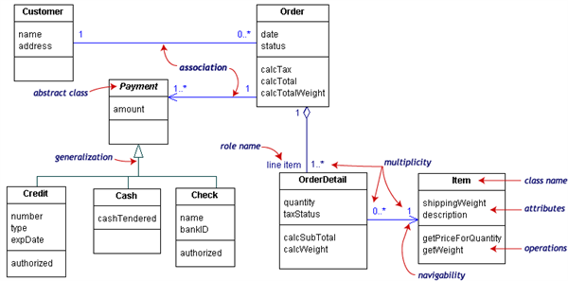
Class Diagrams for Order management System

Slide 40
Packages and Object diagrams
Object Diagram :
An object is an instance of an existing class.
Multiple objects can be pictorially represented in a single diagram.
Package Diagram
Package is a collection of classes.
Package appears as rectangles with small tabs at the top of the rectangle.
Package name is on the tab or inside the rectangle
Object Oriented Analysis and Design, Lecture-3

Slide 41

Packages and Object diagrams
Single Object
Object Name:Class ::package
Attribute = value
Multiple Objects
Object Name:Class ::package
Package
Banking
Object Oriented Analysis and Design, Lecture-3

Slide 42
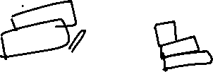
Object diagrams
Some of the objects created for the ATM system are
A:ACCOUNT C:CUSTOMER
type=“Saving” name=“Sachin”
owner=“Sachin” address=“Chennai-20”
dob=‘03/12/1989’
S:SAVING CA:CURRENT
AcNo=“C10005” AcNo=“C231234”
A, C , S and CA are the objects of the classes ACCOUNT,
CUSTOMER,SAVING and CURRENT respectively.
Object Oriented Analysis and Design, Lecture-3

Slide 43
UML Sequence Diagrams
The diagrams which describe how objects collaborate are called as Interaction diagrams.
A sequence diagram is an interaction diagram that specify how operations are carried out and what messages are sent and when.
These diagrams are organized according to time.
The objects involved in the operation are listed from the left to right according to the sequence of the message passed.
Object Oriented Analysis and Design, Lecture-3

Slide 44
UML Sequence Diagrams
A sequence diagram is an interaction diagram dealing with the sequence of messages flowing from one object to another and includes time aspect.
Describes the flow of messages, events, actions between objects
Show concurrent processes and activations
Show time sequences that are not easily depicted in other diagrams
Typically used during analysis and design to document and understand the logical flow of our system.
The following diagrams represent the Use case diagram and Sequence diagram for withdrawing money from ATM machine.
Object Oriented Analysis and Design, Lecture-3

Slide 45
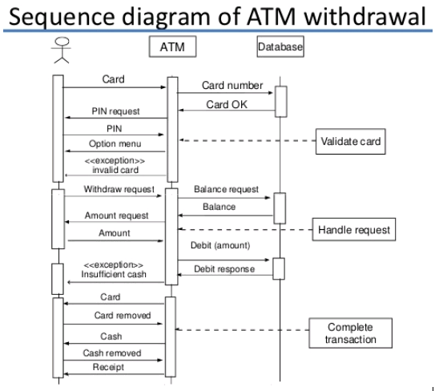

UML Sequence Diagrams – Example
Object Oriented Analysis and Design, Lecture-3
6

Slide 46
An object-oriented design process – Case study
Define the context and modes of use of the system
Design the system architecture
Identify the principal system objects
Develop design models
Specify object interfaces

Slide 47
Weather system description
A weather data collection system is required to generate weather maps on a regular basis using data collected from remote, unattended weather stations and other data sources such as weather observers, balloons and satellites.
Weather stations transmit their data to the area computer in response to a request from that machine.
The area computer validates the collected data and integrates it with the data from different sources.
The integrated data is archived and, using data from this archive and a digitised map database a set of local weather maps is created.
Maps may be printed for distribution on a special-purpose map printer or may be displayed in a number of different formats.

Slide 48
Weather station description
A weather station is a package of software controlled instruments which collects data, performs some data processing and transmits this data for further processing.
The instruments include air and ground thermometers, an anemometer, a wind vane, a barometer and a rain gauge.
Data is collected every five minutes.
When a command is issued to transmit the weather data, the weather station processes and summarises the collected data.
The summarised data is transmitted to the mapping computer when a request is received.

Slide 49
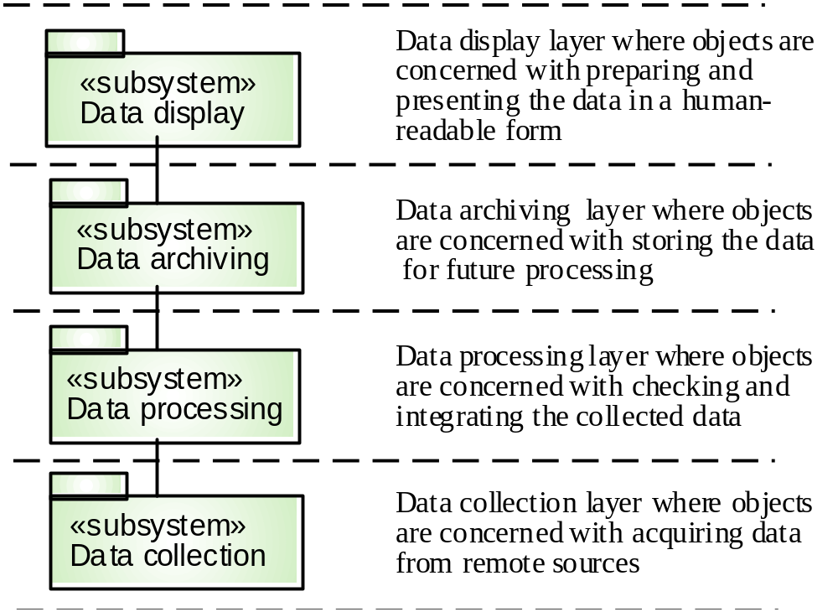
Layered architecture

Slide 50
System context and models of use
Develop an understanding of the relationships between the software being designed and its external environment
System context
  A static model that describes other systems in the environment.
  Use a subsystem model to show other systems.
  Following slide shows the systems around the weather station system.
Model of system use
  A dynamic model that describes how the system interacts with its environment.
  Use use-cases to show interactions

Slide 51
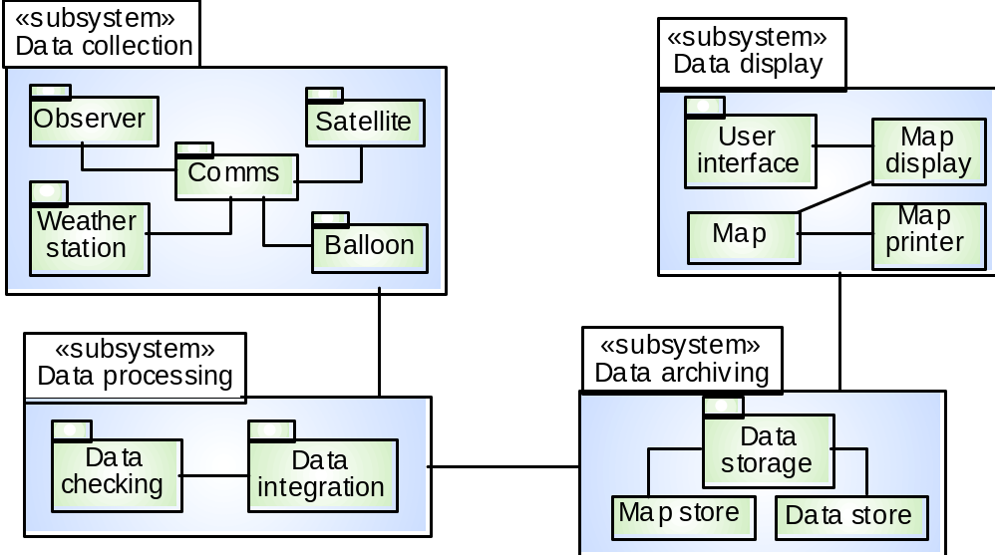
Subsystems in the weather mapping system

Slide 52
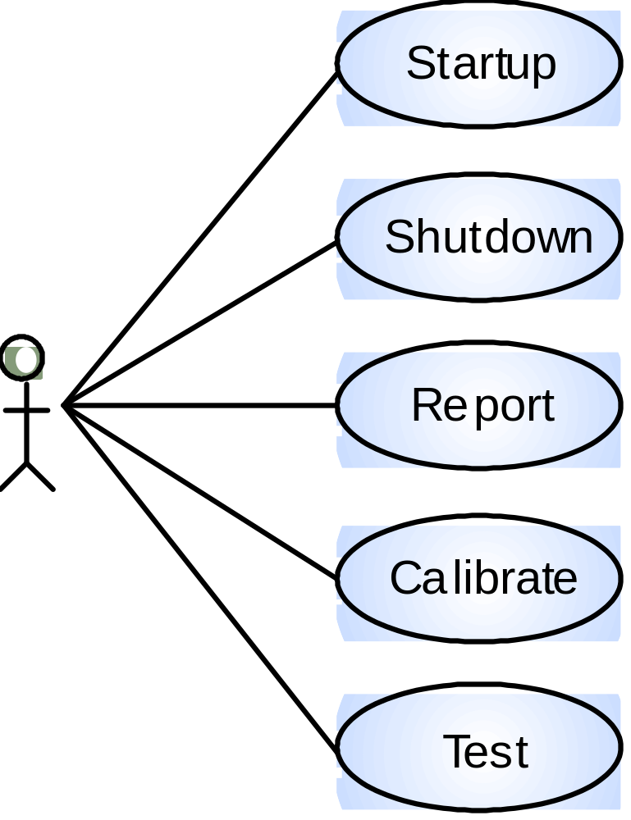
Use-cases for the weather station

Slide 53
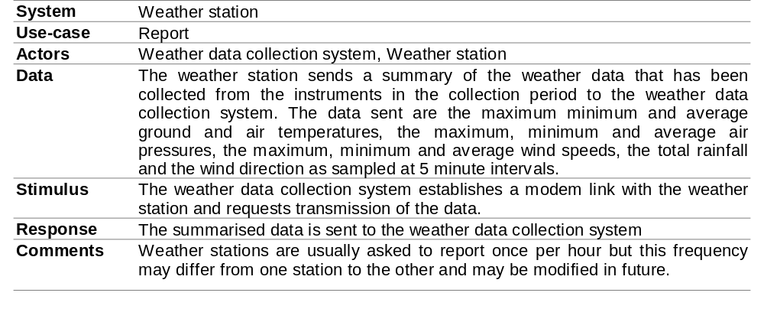
Use-case description

Slide 54
Architectural design
Once interactions between the system and its environment have been understood, you use this information for designing the system architecture
Layered architecture is appropriate for the weather station
  Interface layer for handling communications
  Data collection layer for managing instruments
  Instruments layer for collecting data
There should be no more than 7 entities in an architectural model

Slide 55
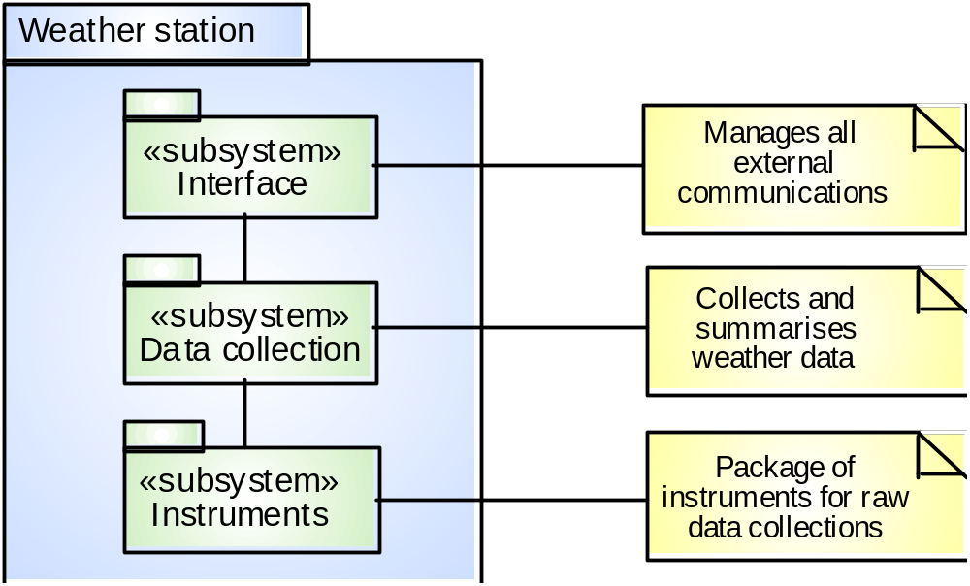
Weather station architecture

Slide 56
Object identification
Identifying objects (or object classes) is the most difficult part of object oriented design
There is no 'magic formula' for object identification.
It relies on the skill, experience and domain knowledge of system designers
Object identification is an iterative process.
You are unlikely to get it right first time

Slide 57
Approaches to identification
Use a grammatical approach based on a natural language description of the system (used in Hood method)
Base the identification on tangible things in the application domain
Use a behavioural approach and identify objects based on what participates in what behaviour
Use a scenario-based analysis.
The objects, attributes and methods in each scenario are identified

Slide 58
Weather station object classes
Ground thermometer, Anemometer, Barometer
  Application domain objects that are ‘hardware’ objects related to the instruments in the system
Weather station
  The basic interface of the weather station to its environment. It therefore reflects the interactions identified in the use-case model
Weather data
  Encapsulates the summarised data from the instruments

Slide 59
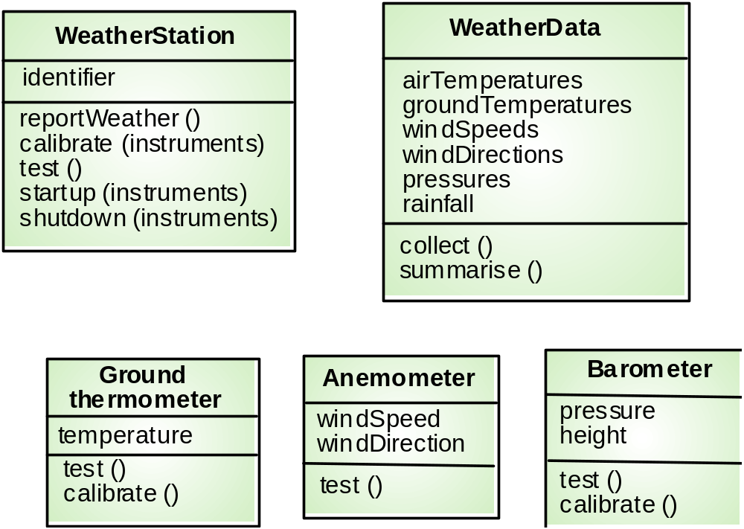
Weather station object classes

Slide 60
Further objects and object refinement
Use domain knowledge to identify more objects and operations
  Weather stations should have a unique identifier
  Weather stations are remotely situated so instrument failures have to be reported automatically. Therefore attributes and operations for self-checking are required
Active or passive objects
  In this case, objects are passive and collect data on request rather than autonomously. This introduces flexibility at the expense of controller processing time

Slide 61
Design models
Design models show the objects and object classes and relationships between these entities
Static models describe the static structure of the system in terms of object classes and relationships
Dynamic models describe the dynamic interactions between objects.

Slide 62
Examples of design models
Sub-system models that show logical groupings of objects into coherent subsystems.
State machine models that show how individual objects change their state in response to events
Sequence models that show the sequence of object interactions
Other models include use-case models, aggregation models, generalisation models, etc.

Slide 63
Subsystem models
Shows how the design is organised into logically related groups of objects and / or packages.
In the UML, these are shown using packages - an encapsulation construct.
This is a logical model.
The actual organisation of objects in the system may be different.

Slide 64
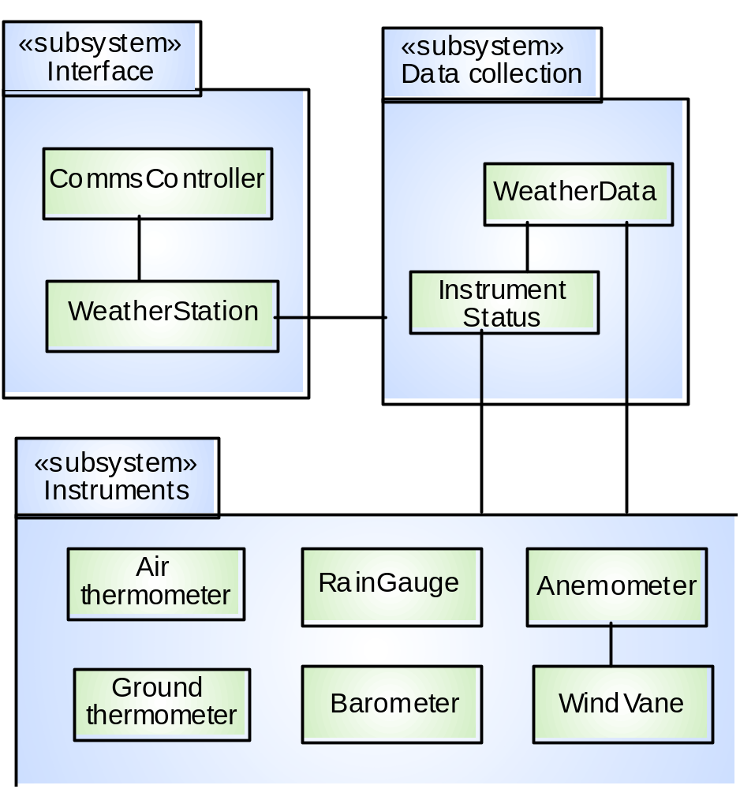
Weather station subsystems

Slide 65
Sequence models
Sequence models show the sequence of object interactions that take place
  Objects are arranged horizontally across the top
  Time is represented vertically so models are read top to bottom
  Interactions are represented by labelled arrows, Different styles of arrow represent different types of interaction
  A thin rectangle in an object lifeline represents the time when the object is the controlling object in the system

Slide 66
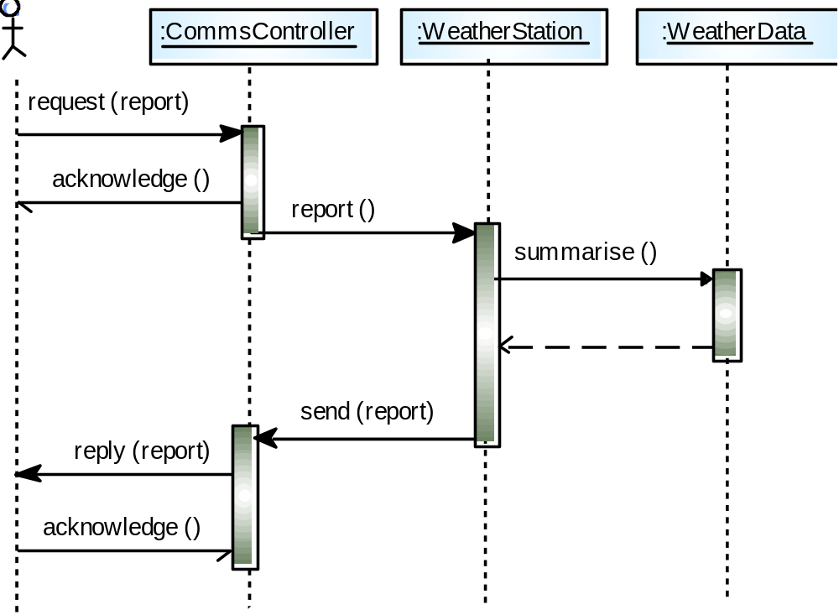
Data collection sequence

Slide 67
Key points
OOD is an approach to design so that design components have their own private state and operations
Objects should have constructor and inspection operations. They provide services to other objects
Objects may be implemented sequentially or concurrently.
The Unified Modeling Language provides different notations for defining different object models

Slide 68
Key points
A range of different models may be produced during an object-oriented design process. These include static and dynamic system models
Object interfaces should be defined precisely using e.g. a programming language like Java
Object-oriented design simplifies system evolution
Write simple Java code to represent the Weather System.

Slide 69


Slide 70
Thank You

